Slide 1

Data Structures
Lecture 17: AVL Trees

Slide 2

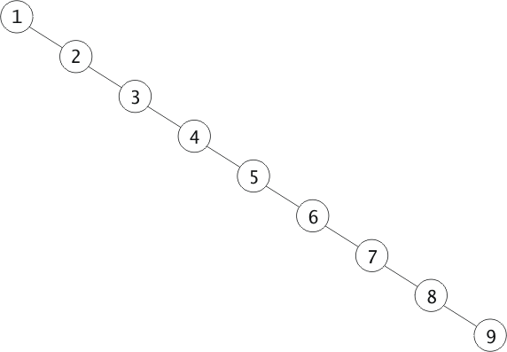
Unbalanced Binary Search Trees
The performance of binary search trees on average is O (log n).
However, if the tree is heavily unbalanced, the performance could be O(n)
The
“The quick brown fox jumps over the lazy dog”
quick
brown
the
fox
dog
jumps
over
lazy

Slide 3
Rotation
  Rotation helps us change the relative height of left & right subtrees while preserving the binary search tree property
  root
  root
20
The Algorithm for Rotating Right
  temp
10
40
  1. Save value of root->left (temp = root->left)
  2. Set root->left to value of root->left->right
  3. Set temp->right to root
  4. Set root to temp
5
15
7

Slide 4
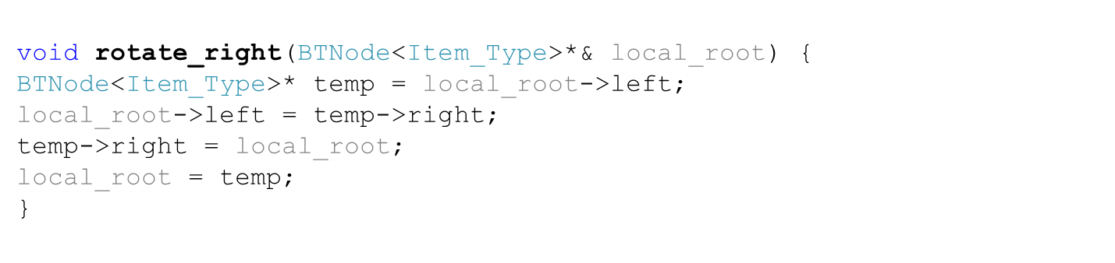
Rotation Right (Source Code)
  root
  root
20
  temp
10
40
5
15
7

Slide 5
Rotation Left
  root
  temp
  1. Save value of root->right (temp = root->right)
  2. Set root->right to value of root->right->left
  3. Set temp->left to root
  4. Set root to temp
  root
20
40
  root
  temp
10
20
40
50
10
23
50
23
45
45

Slide 6
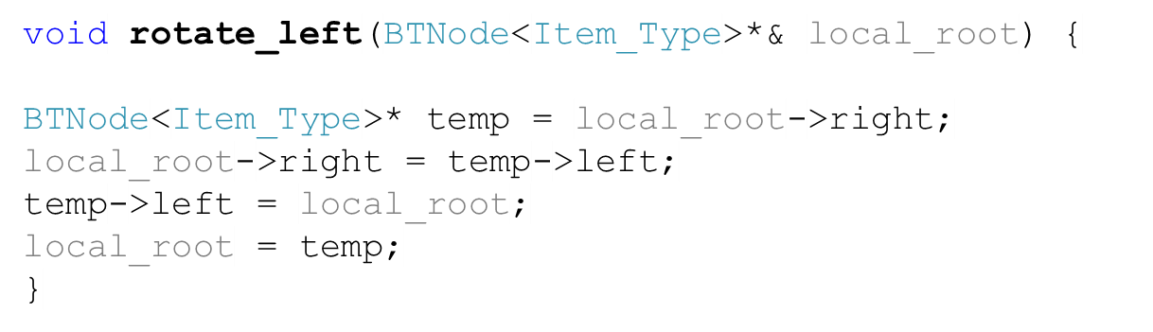
Rotation Left (Source Code)
  root
  temp
  root
20
40
  root
  temp
10
20
40
50
10
23
50
23
45
45

Slide 7

AVL Trees
Two Russian mathematicians, G.M. Adel’son-Vel’ski and E. M. Landis, published a paper in 1962 that describes an algorithm for maintaining overall balance of a binary search tree. Trees using this approach are known as AVL trees after the initials of the inventors.
50
-2
40
-1
20
0

Slide 8
Balancing a Left-Left Tree
To balance a left-left tree, we rotate right around parent.
Left-Heavy
50
-2
Left-Heavy
Balanced
40
0
-1
Balanced
20
0
0
50
Balanced

Slide 9
Balancing a Left-Right Tree (1)
Can we balance it by rotating the root to the right?
No, we can’t
Left-Heavy
-2
50
+2
+1
Right-Heavy
Right-Heavy
20
0
-1
50
40
Left-Heavy
0
40

Slide 10
Balancing a Left-Right Tree (2)
Instead, we should rotate left around child.
This will make it a left-left tree.
Now we rotate right around parent.
-2
-2
50
0
-1
+1
40
20
0
0
0
0
20
50
40

Slide 11
Balancing a Right-Right Tree
To balance a right-right tree, rotate left around parent.
+2
Right-Heavy
50
0
Right-Heavy
+1
60
0
0
0
50
70

Slide 12
Balancing a Right-Left Tree
To balance a right-left tree, rotate right around child first. This will make it a right-right tree.
Now rotate left around parent.
+2
+2
Right-Heavy
50
0
+1
-1
60
Left-Heavy
55
0
0
0
0
50
55
60

Slide 13
Example on Building an AVL tree
+2 Right-Heavy
0 Balanced
+2 Right-Heavy
“The quick brown fox jumps over the lazy dog”
+1 Right-Heavy
The
+1 Right-Heavy
0 Balanced
-1 Left-Heavy
0 Balanced
+2 Right-Heavy
+2 Right-Heavy
+1 Right-Heavy
quick
brown
0 Balanced
0 Balanced
0 Balanced
0 Balanced
0 Balanced
-2 Left-Heavy
-2 Left-Heavy
-1 Left-Heavy
0 Balanced
0 Balanced
The
brown
jumps
quick
+1 Right-Heavy
-1 Left-Heavy
0 Balanced
fox
fox
jumps
0 Balanced
0 Balanced
quick
fox
jumps

Slide 14
Example on Building an AVL tree
“The quick brown fox jumps over the lazy dog”
+1 Right-Heavy
+2 Right-Heavy
brown
0 Balanced
0 Balanced
+1 Right-Heavy
0 Balanced
0 Balanced
0 Balanced
The
jumps
0 Balanced
0 Balanced
0 Balanced
+1 Right-Heavy
0 Balanced
-1 Left-Heavy
-1 Left-Heavy
-1 Left-heavy
fox
brown
quick
-1 Left-Heavy
0 Balanced
0 Balanced
The
-1
fox
over
the
0 Balanced
dog
0 Balanced
0 Balanced
lazy
0 Balanced
0 Balanced

Slide 15

Task
Show the final AVL tree for the changes as you insert “apple”, “cat”, and “hat”.
0
jumps
+1
-1
0
brown
quick
-1
-1
0
The
fox
over
the
0
0
dog
lazy

Slide 16
Task – Solution (1)
After inserting “apple”
0
jumps
0
-1
+1
brown
-1
quick
-1
0
The
fox
over
0
the
0
0
dog
lazy
apple

Slide 17
Task – Solution (2)
Inserting “cat”
-1
jumps
+1
-1
+1
brown
-1
quick
-2
0
The
fox
over
-1
0
the
0
dog
lazy
apple
0
cat

Slide 18
Task – Solution (3)
After inserting “cat”
0
jumps
0
-1
+1
brown
-1
quick
0
0
The
dog
over
0
0
the
0
0
cat
fox
lazy
apple

Slide 19
Task – Solution (4)
After inserting “hat”
-1
jumps
+1
-1
+1
brown
-1
quick
+1
0
The
dog
over
0
0
the
+1
0
cat
fox
lazy
apple
0
hat

Slide 20
Task
Build an AVL tree from the following integers: 10, 18, 14, 16, 20, 25.
Please insert the integers in the specified sequence, and show what happens after inserting every integer

Slide 21
Solution
+2
+1
0
10
10, 18, 14, 16, 20, 25
+2
+1
0
+1
-1
0
14
18
0
0
0
+1
0
0
18
-1
10
14
0
+1
+1
20
0
14
0
16
0
0
0
25
10
16

Slide 22
Implementing AVL Trees
The basic building block of AVL trees is an AVL node.
Each AVL node keeps track of the height of the right subtree and the height of the left subtree. It computes the balance on demand.
Whenever we add/delete a node, we might change the left height or the right height of the parent. Then, by means of recursion, we perform rotations if the parent’s balance is +2 or -2.
0
-1
-1
lh=1
rh=1
-1
lh=2
rh=1
Add a node
lh=2
rh=1
Add a node
+1
0
0
rh=1
0
0
0
+1
0
lh=0
lh=1
rh=1
lh=0
rh=0
lh=0
rh=1
0

Slide 23
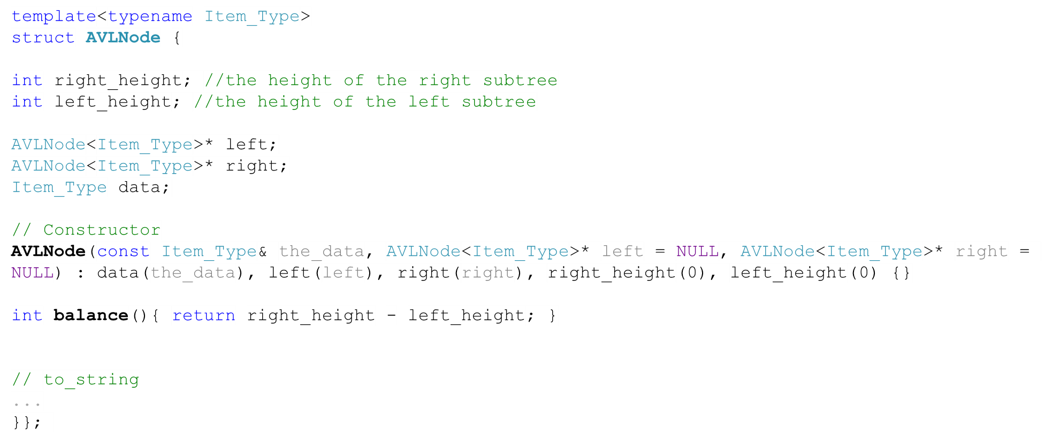
AVL_Node (1)

Slide 24
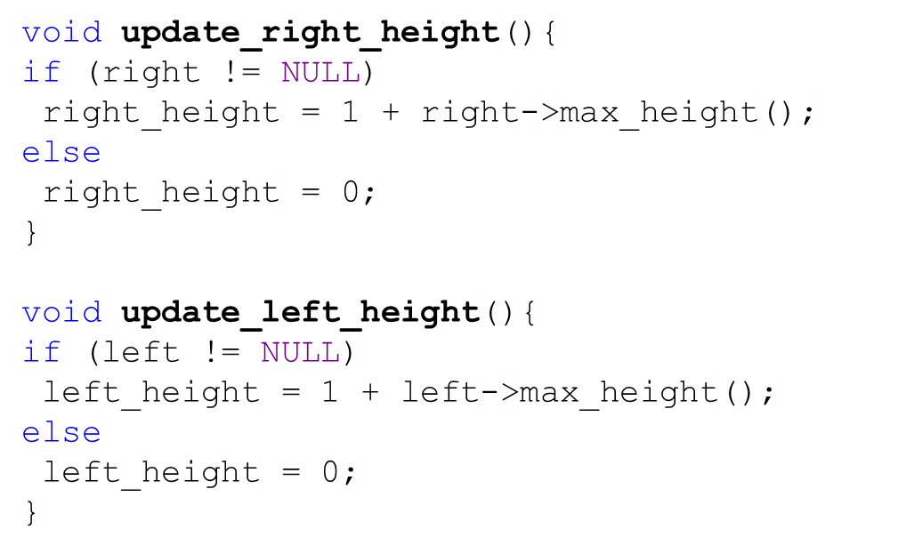
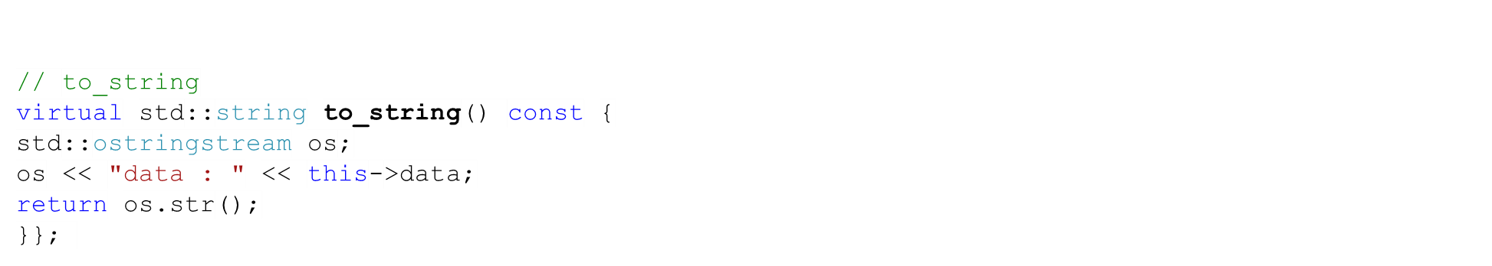
AVL_Node (2)

Slide 25
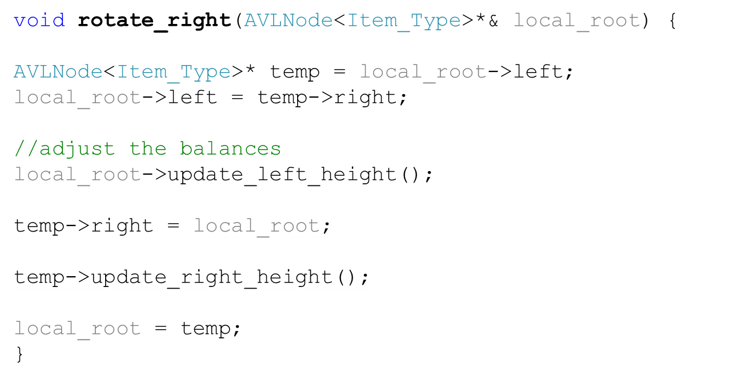
rotate_right
Left-Heavy
lh=2 -2 rh=0
50
Left-Heavy
Balanced
lh=1 -1 rh=0
40
0 rh=1
Balanced
lh=0 0 rh=0
20
50
Balanced
lh=0 0 rh=0

Slide 26

rotate_right
lh=2 -2 rh=0
50
lh=1 -1 rh=0
40
+1 rh=2
lh=1 -1 rh=0
lh=1 -1 rh=0
20
40
0 rh=1
50
lh=0 0 rh=0
lh=0 0 rh=0
20
45
45
lh=0 0 rh=0
lh=0 0 rh=0

Slide 27
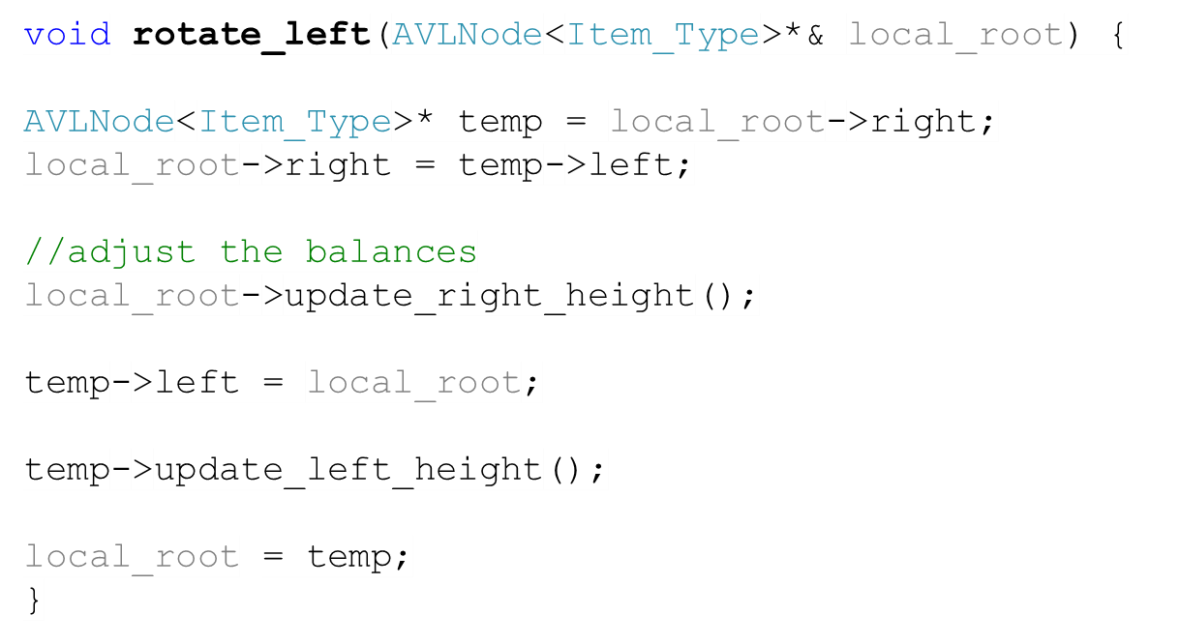
rotate_left
lh=0 +2 rh=2
Right-Heavy
50
lh=1 0 rh=1
Right-Heavy
lh=0 +1 rh=1
60
50
70
lh=0 0 rh=0
lh=0 0 rh=0
lh=0 0 rh=0

Slide 28

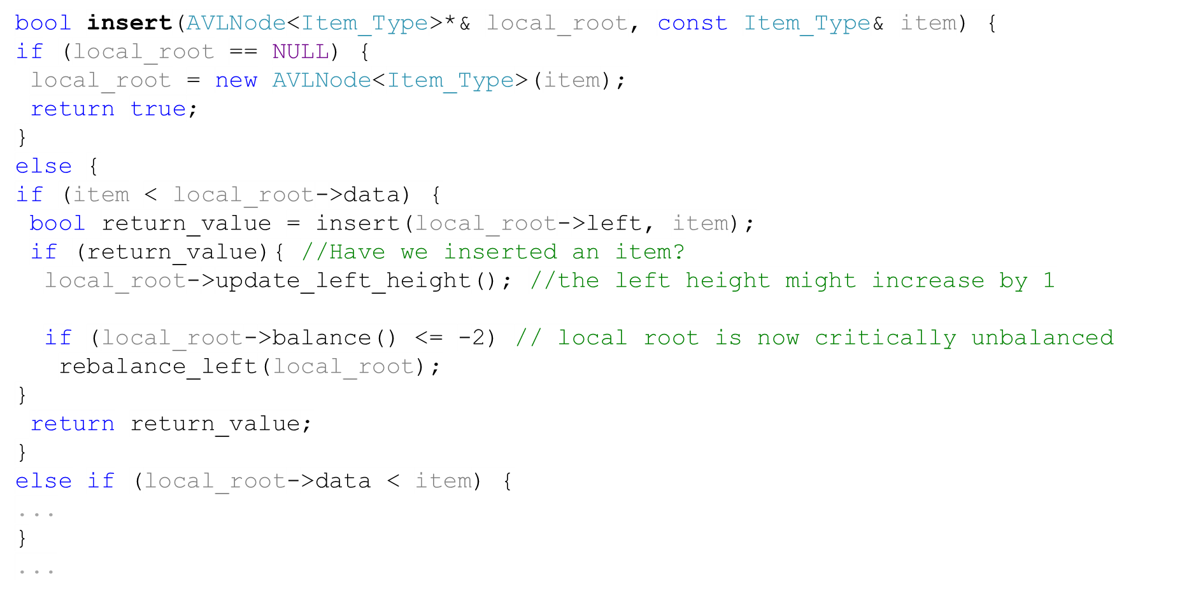
A Function for Insertion into an AVL Tree
Example:
Left-Left Tree (1)
5,4,3
lh=2 -2 rh=0
lh=1 -1 rh=0
lh=0 0 rh=0
lh=1 -1 rh=0
5
lh=0 0 rh=0
4
lh=0 0 rh=0
3

Slide 29
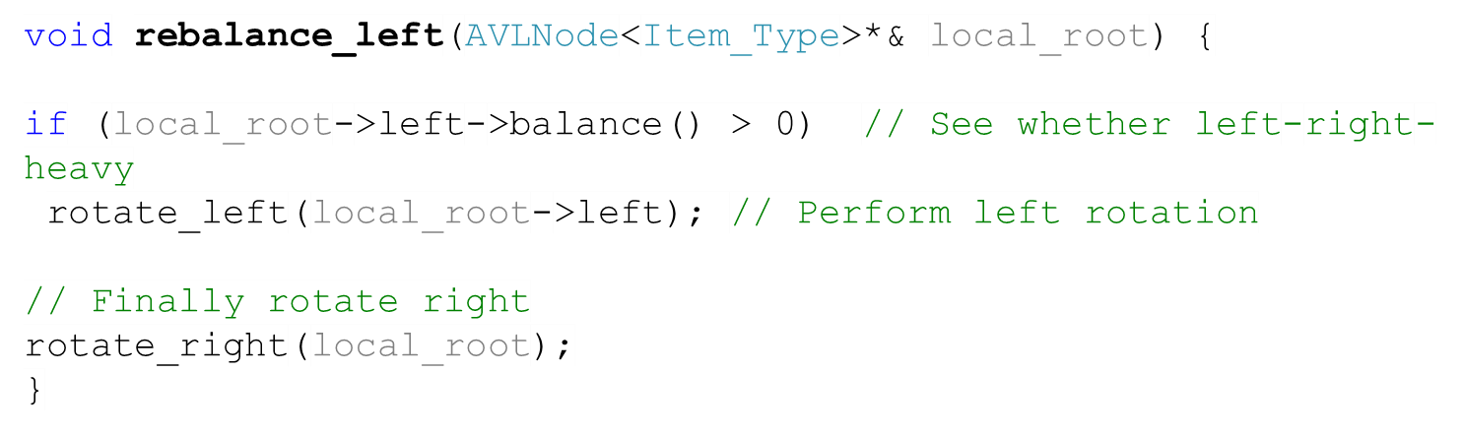
A Function for Insertion into an AVL Tree
Example:
Left-Left Tree (2)
lh=2 -2 rh=0
lh=1 -1 rh=0
5
lh=1 0 rh=1
4
lh=0 0 rh=0
lh=0 0 rh=0
3
5

Slide 30
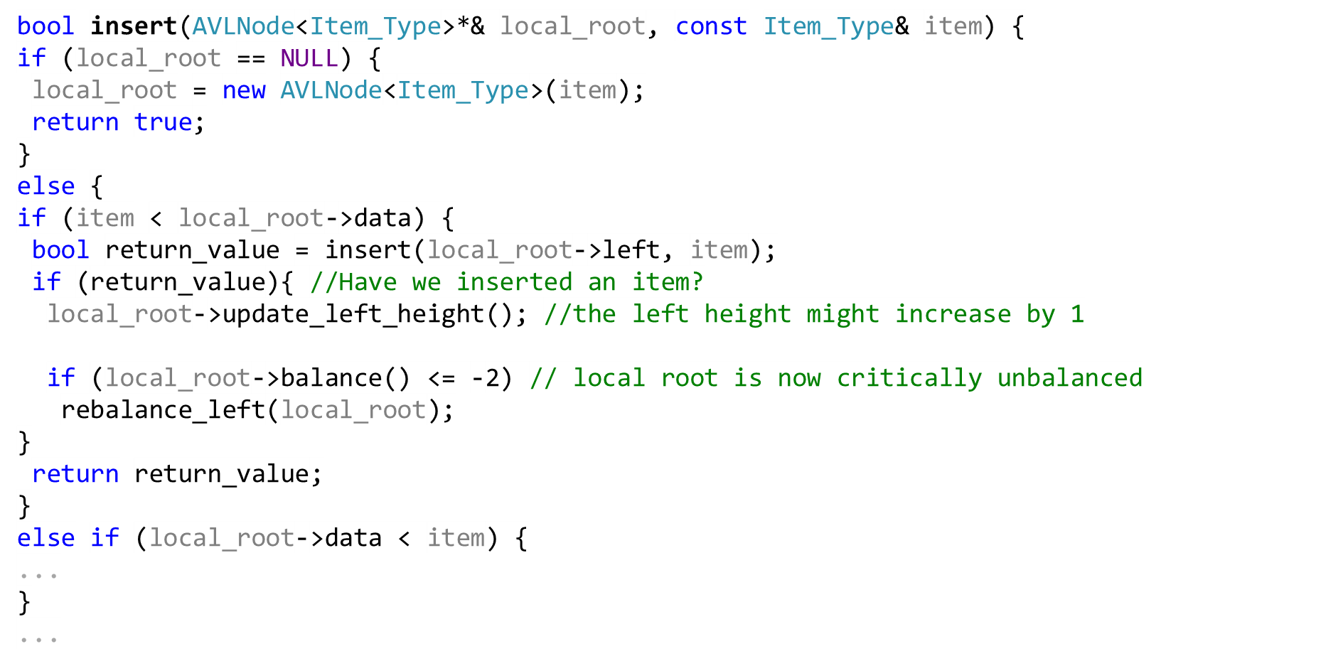
A Function for Insertion into an AVL Tree
Example:
Left-Right Tree (1)
6,4,5
lh=1 -1 rh=0
lh=0 0 rh=0
6
lh=0 0 rh=0
4

Slide 31
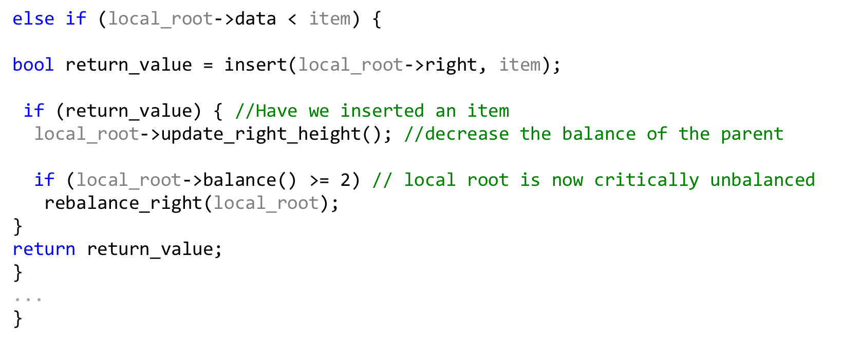
A Function for Insertion into an AVL Tree
Example:
Left-Right Tree (2)
6,4,5
lh=1 -1 rh=0
lh=0 0 rh=0
lh=0 +1 rh=1
6
lh=0 0 rh=0
4
lh=0 0 rh=0
5

Slide 32
A Function for Insertion into an AVL Tree
Example:
Left-Right Tree (3)
6,4,5
lh=2 -2 rh=0
lh=1 -1 rh=0
lh=0 0 rh=0
lh=0 +1 rh=1
6
lh=0 0 rh=0
4
lh=0 0 rh=0
5

Slide 33
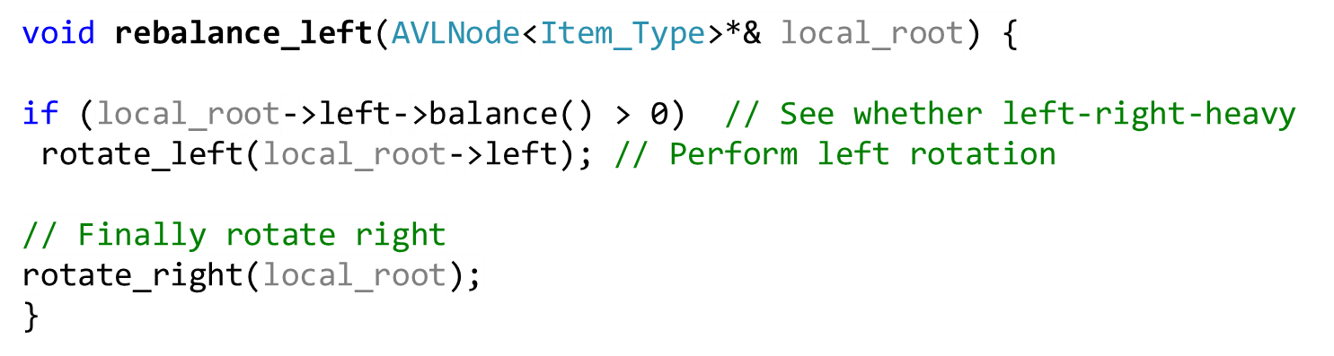
A Function for Insertion into an AVL Tree
Example:
Left-Right Tree (4)
lh=2 -2 rh=0
lh=2 -2 rh=0
lh=1 0 rh=1
6
6
lh=0 +1 rh=1
5
lh=1 -1 rh=0
lh=0 0 rh=0
5
4
4
lh=0 0 rh=0
6
4
5
lh=0 0 rh=0
lh=0 0 rh=0

Slide 34
A Nice Illustration on AVL Trees
http://www.cs.usfca.edu/~galles/visualization/AVLtree.html

Slide 35
Task
Write an algorithm that converts an unbalanced binary search tree into a balanced binary search tree
8
9
11
10
9
13
11
10
14
8
12
12
13
14

Slide 36
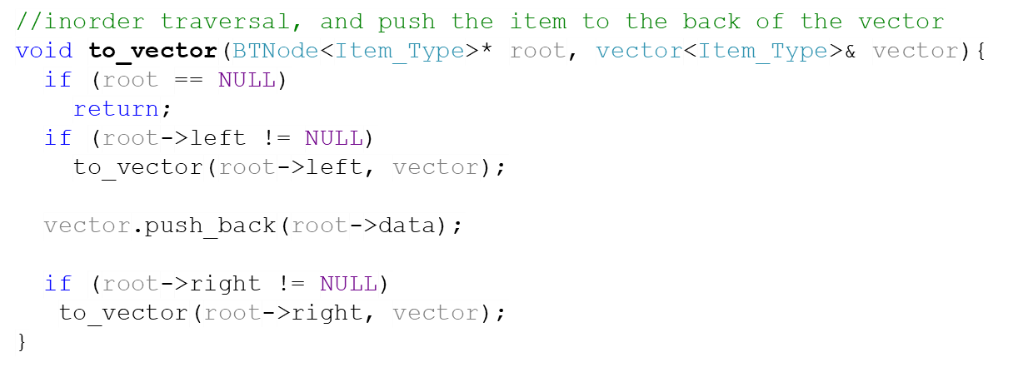
Possible Solution
8
9
Step 1: Convert the binary search tree into a sorted array using inorder traversal
10
11
12
13
14
8 | 9 | 10 | 11 | 12 | 13 | 14

Slide 37
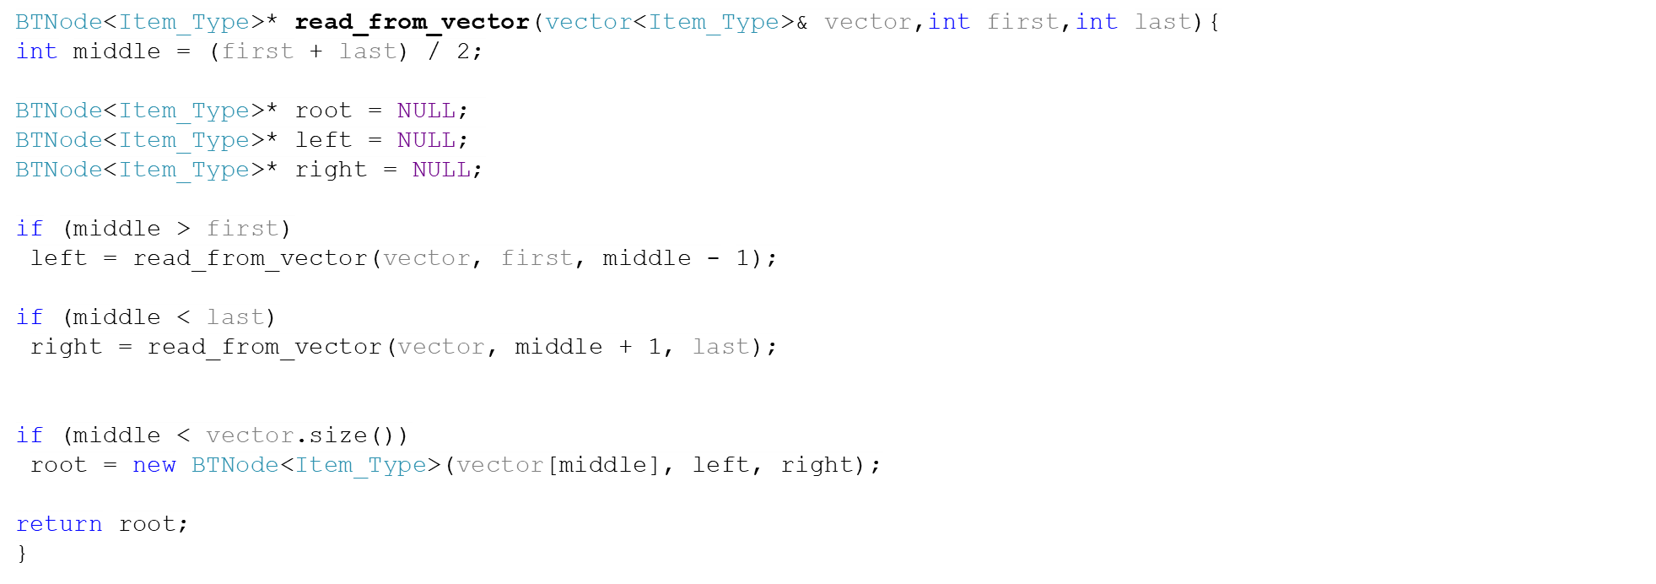
Possible Solution
Step 2: Convert the sorted array into a binary search tree.
11
9
13
10
14
8
12
8 | 9 | 10 | 11 | 12 | 13 | 14

Slide 38
Possible Solution
8
Keep rotating until the tree gets balanced.
9
void balance_tree(Node local_root){
If(local_root!=NULL){
while(local_root.balance() < =-2)
balance_left(local_root);
while(local_root.balance()>=2)
balance_right(local_root);
if(local_root->left!=NULL)
balance_tree(local_root->left);
if(local_root->right!=NULL)
balance_tree(local_root->right);
}
}
10
11
12
13
14

